Slide 1
Hantering av biverkningar av Alpelisib
Christine Lundgren 2024-11-28 (anpassad från Gallagher E, npj Breast Cancer 2024 samt riktlinjer från Region Örebro län

Slide 2
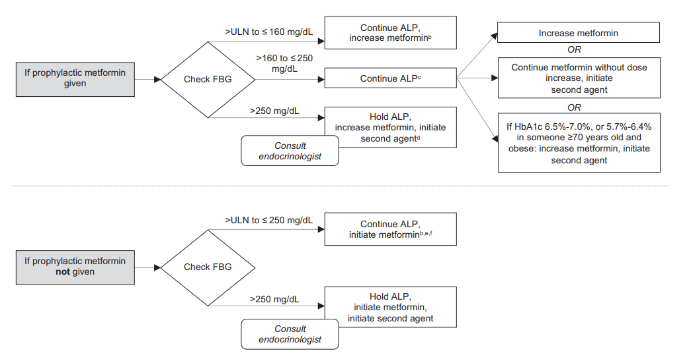
Hantering av hyperglykemi
Grad 1
Grad 2
Grad 3-4
160mg/dL=9mmol/L
250mg/dL=14mmol/L
500mg/dL=24.7mmol/L
Max dose Metformin titration =2000mg daily
SGLT2i or TZD as 2nd line
DPP4i as 3rd line
Insulin as rescue
Grad 1-2
Grad 3-4

Slide 3
Management Task regarding Hyperglycemia | Recommendation
Risk assessment by Oncologist | Assess risk pf alpelisib-induced hyperglycemia based on FPG and HbA1c Assess other risk factors as age, BMI, history of known diabetes or gestational diabetes
Lifestyle advice | Advice a sugar-free, fiber-rich diet with moderate carbohydrate intake (60-130g or ca 30% of daily calories) Moderate to vigorous-intense aerobic exercise of 150min/week spread over 3 days/week Avoidance of all suger-sweetened beverages and foods with high glycemic index Limit alcohol intake
Consultation with specialist | Refer patients with pre-diabetes or diabetes before treatment initiation Refer patinets with alpelisib-induced hyperglycemia if metformin is not enough
Preventive strategies | Metformin 500mg x 2 → 1000mg x 2 (high risk patients)
Education | Educate patients about lifestyle modifications Educate patients about symtoms and signs of hyperglycemia

Slide 4
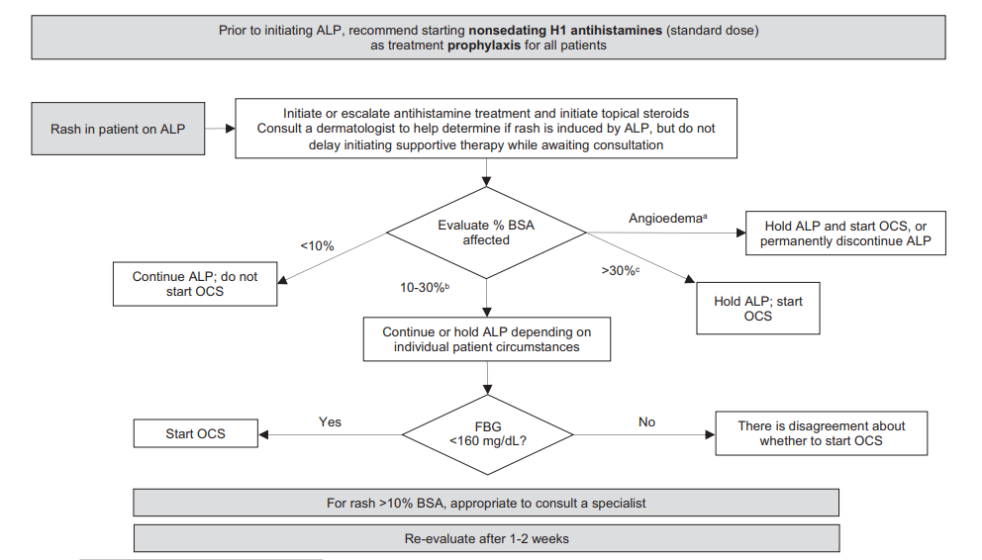
Hantering av hudbiverkningar
Prophylaxis (for 8 weeks):
10mg cetirizine
10mg loratidine
Rash despite prophylaxis:
Topical steriods (I-III)
Escalation of nonsedative H1
Sedative antihistamines
Systemic corticosteriods:
Intorable grade 2 or grade 3 or angioedema
0.5mg/kg/d prednisone 10-14days with taper

Slide 5
Management Task regarding skin toxicity | Recommendation
Risk assessment by Oncologist | Patients with skin diseases and/or dry skin might be of higher risk for alpelisib-induced skin toxicity
Lifestyle advice | Advise patients to avoid sun exposure and irritant products Advise patients to use mild, fragrance-free soap for bathing and detergents for clothes to prevent skin dryness
Consultation with specialist | Consider in grad >1
Preventive strategies | Antihistamines once daily for the first 8 weeks of treatment
Education | Educate patients about lifestyle modifications related to skin care Educate patients about early symptoms of alpelisib-induced skin toxicity as prutitus, dry skin, tighness or burning sensation

