Slide 1
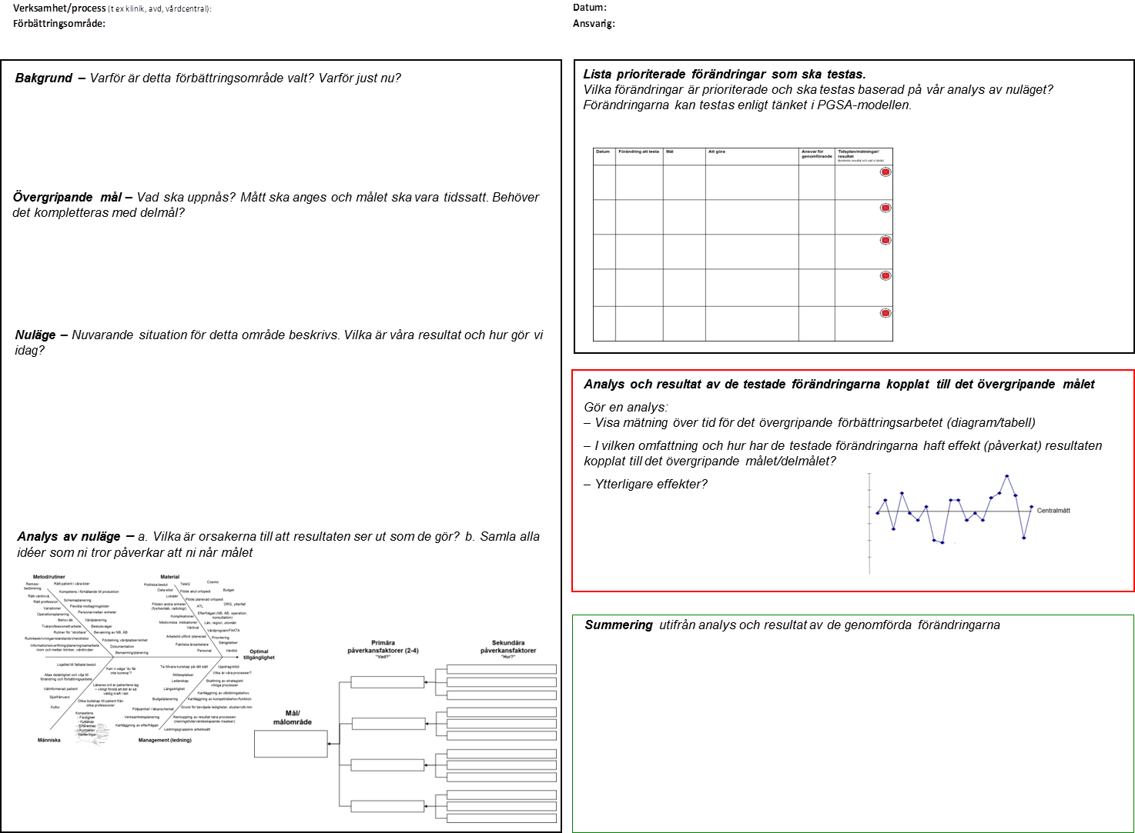
Så hänger fiskben, påverkansanalys, handlingsplan och mätningar ihop med A3
Notes:
Do quick review of the A3.
Key points:
Follows PDSA
Left hand side is the P (Plan)
Right hand side is DSA (Do Study Act)
This balance reflects the emphasis on understanding the situation. (Share quote: “If I have an hour to solve a problem, give me 59 minutes to define the problem and one minute to solve it”)
So our focus today will be on the background and problem statement.

